Slide 1
PROCESS AND THREADS

Slide 2
Synchronization Mechanism
Processes should be synchronized.
Synchronization of a process is normally achieved by regulating the flow of execution.

Slide 3
PROCESS
It is a program in execution( execution has started but yet to complete)

Slide 4



An example to spot the difference between process and thread

Slide 5
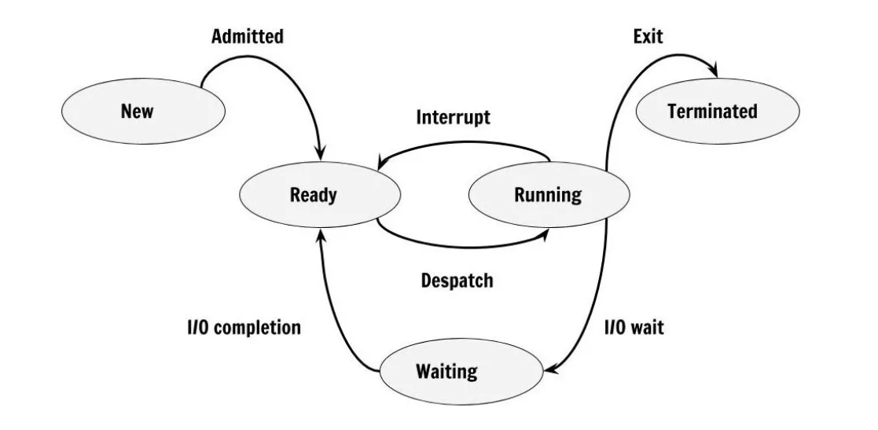
State diagram of a process

Slide 6
A process can be in any of the following basic states
Running-The processor is executing the instructions of the corresponding process
Ready-The process is ready to be executed,but the processor is not available for the execution of the process.
Blocked-The process is waiting for an event to occur
Eg:) I/o operations completed,memory to be made available,a message to be received.

Slide 7
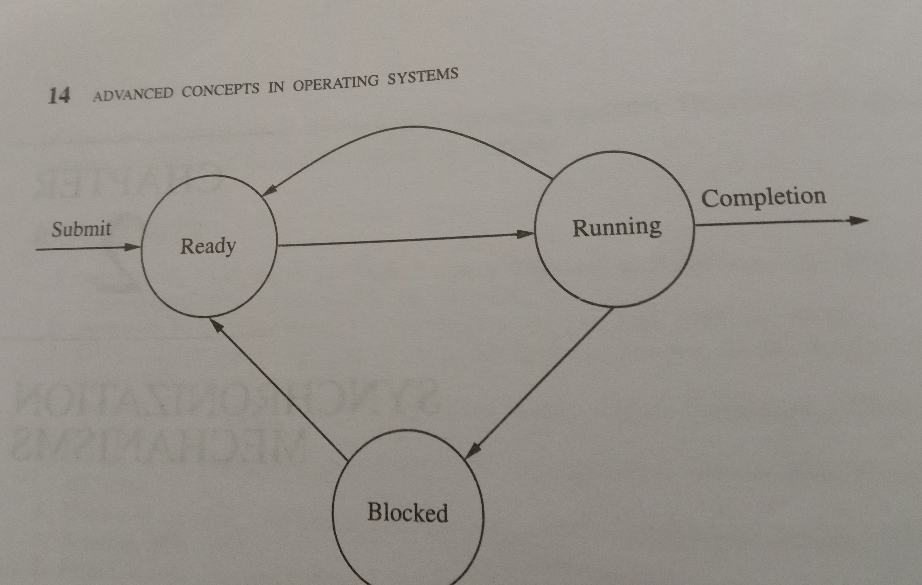

Slide 8
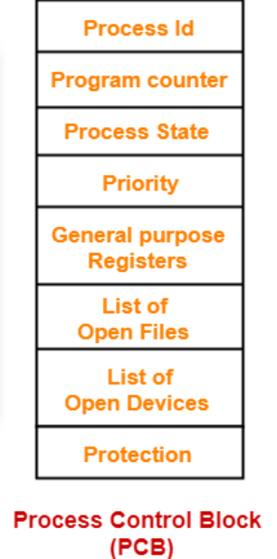
PROCESS CONTROL BLOCK(PCB)
Its a datastructure
Stores such as process id,process state,priority,privileges etc

Slide 9
CONCURRENT PROCESS
Concurrent if their execution maps together
Physical concurrency is several program units from the same program that literally execute simultaneously.
For eg in single CPU system,physical concurrency can be due to concurrent execution of CPU and I/0
Logical concurrency is multiple processors providing actual concurrency, when in fact the actual execution of programs is taking place in interleaved fashion on a single processor.
For eg in multiprocessor system CPU can simultaneously execute the process

Slide 10
Shared variables and Message Passing
Shared variables: Process accessing(read/write) a common variable or data
Message passing: The processes exchange information with each other by sending and receiving messages

Slide 11
THREADS a.How a process is different from threads?
Process has single address space and single thread of execution
Initialize and maintain state information
State information-page tables,swap images,file descriptors,outstanding I/O requests,saved register values
Info is maintained per process basis which creates difficulty in switching between process

Slide 12
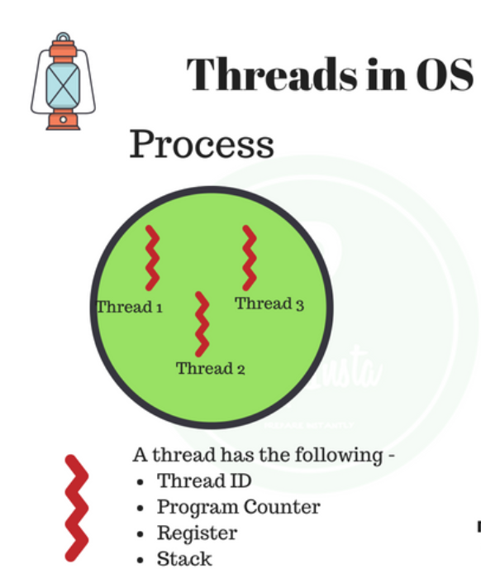
To handle situations where creating,maintaining and switching between processes occur frequently,threads or LWP(light weight processes has been introduced)

Slide 13
A single thread executes a portion of the program ,cooperating with other threads concurrently executing within the same address space.
Why thread is known as light weight process(LWP)?
Threads are "lightweight" because threads can interact without the need of inter-process communication(IPC). Switching between threads is "cheaper" than switching between processes (again, just moving some pointers around). And inter-process communication requires more expensive communication than threads

Slide 14
